Slide 1
Handling Asynchronous Operations

Slide 2
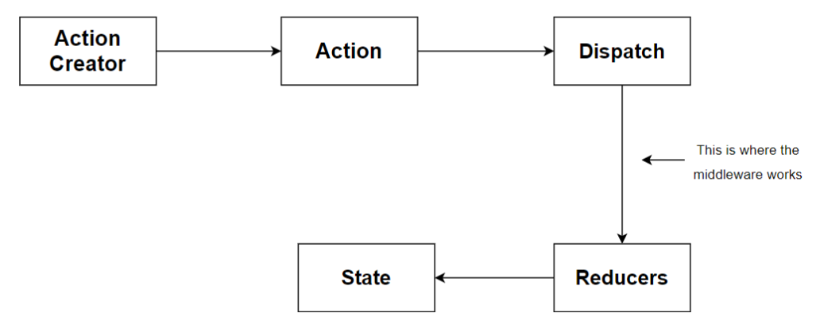
Redux flow without Thunk

Slide 3
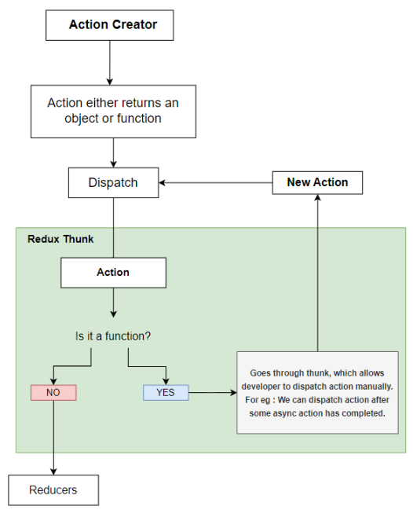
Redux Flow with Thunk

Slide 4
Middleware and Redux Data Flow

Slide 5
Handling asynchronous operations with createAsyncThunk
Hands-on Lab 3.1
The goal is to fetch a list of products from a mock API, and manage the loading, success, and error states.
We'll create a new slice for products and a new component to display the data.

Slide 6
Advanced Async Patterns (RTK Query)
Automatic Caching
Boilerplate Reduction
Server-Side Data Synchronization

Slide 7
Refactor the previous lab to use RTK Query.
Hands-on Lab 3.2

Slide 8
Next up:
Advanced Concepts & Best Practices

